Slide 1

Gulp Intro for the .NET Developer
Justin James

Slide 2
Why Use Gulp?

Slide 3

What Can You Do?
Minify
Concat
Less/Sass to CSS Compilation
Injecting Files into HTML
Generate Javascript Source Maps
TypeScript to JavaScript
Testing
Code Analysis

Slide 4
Why Should You Care?
Improve Quality
Deliver Faster
Repeatable
and Consistent
Notes:
The less work you have to do when performing repetitive tasks like minification, compilation, unit testing, linting, running tests, the easier your job becomes. Once configure, a task runner can do the mundane work for your team with basically zero effort.

Slide 5
Gulp Overview
Gulpfile.js
Code over configuration
Stream based
1100+ plugins
Notes:
Resources:
Cheatsheet - https://github.com/osscafe/gulp-cheatsheet
Learning Gulp http://hmphry.com/gulp/

Slide 6
Typical Gulp Task
File System
Dest
Read Files
jshint
uglify
concat
Write Files

Slide 7
4
Gulp APIs

Slide 8
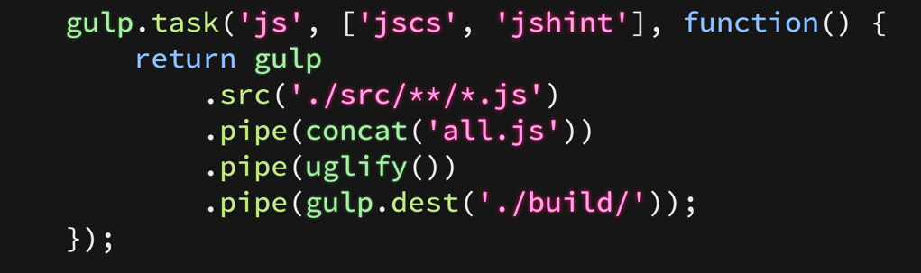

1. gulp.task ( name [, dep], fn )
Register a task named js with a function
Declared optional dependencies (jscs & jshint)
Dependency tasks run in parallel, not in sequence

Slide 9
2. gulp.src ( glob [, options] )
Takes a file system glob (set of files)
Emits files that match
Optionally specify options to apply to the glob

Slide 10
3. gulp.dest ( folder [, options] )
Piped files are written to the file system
Optionally specify options to apply to the output folder

Slide 11
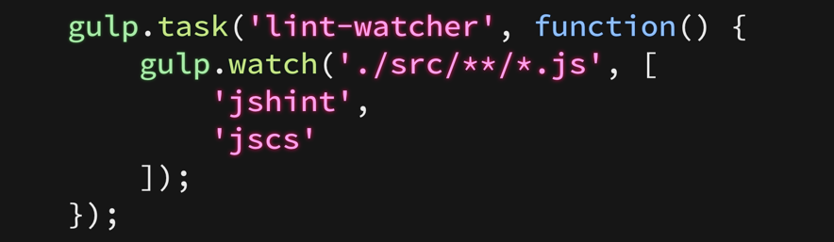

4. gulp.watch ( glob [, options], tasks )
Run one or more tasks when a file matched by the glob changes
Array of task names

Slide 12
Installing Gulp

Slide 13
Getting Node.js
Manual Install
Automated Install
Run installer from
http://nodejs.org
Install Chocolatey
https://chocolatey.org/
choco install nodejs

Slide 14
Install Gulp and Bower
$ npm install –g gulp
We’ll be needing the CLI
-g is a global install
Enables Gulp’s command line interfaces (CLI)

Slide 15
Install Gulp Locally
$ npm install gulp --save-dev
Installs gulp local for a project
--save-dev saves it to devDependencies in package.json

Slide 16
var gulp = require(gulp);
gulp.task('default', function() {
console.log(‘Our first gulp task’);
});
Use require to reference gulp and any gulp tasks
Create task called default
Run via command line: $ gulp or $gulp default

Slide 17
Demo
Notes:
Create gulpfile.js from scratch
Add javascript compress
gulp-uglify
uglify()
ISSUES:
Even vendor scripts are included
['./www/**/*.js', '!./www/lib/**/']
Files are not renamed with a .min
Solution:
gulp-rename
rename({ extname: '.min.js' })
Existing Files are Not Deleted First
Solution:
rimraf
gulp.task("clean", function (cb) {
rimraf('./dist', cb);
});
Add javascript concat
gulp-concat
Combine uglify and concat
Default task
gulp.task('default', ['sass', 'index']);
Watch Task
gulp.task('watch', function() {
gulp.watch(paths.sass, ['sass']);
gulp.watch([
paths.javascript,
paths.css
], ['index']);
});
Inject Javascript into index.html
gulp-inject
<!-- inject:js -->
<!-- endinject -->
Create Source Maps
gulp-sourcemaps

Slide 18
Running Tasks in Visual Studio

Slide 19
Tasks in Visual Studio
Runs gulp tasks from Visual Studio
Use existing tasks
Add actions via custom bindings

Slide 20
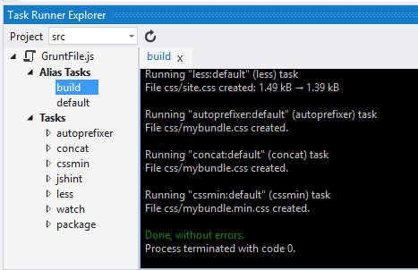
Task Runner Explorer

Slide 21
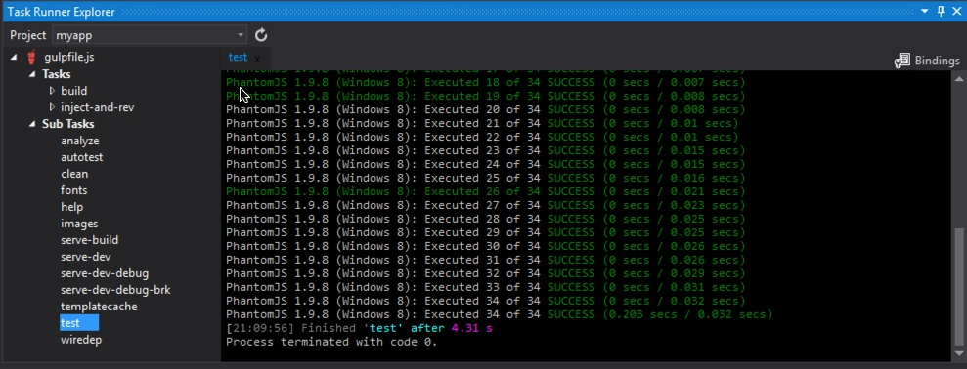
Task Runner Explorer

Slide 22
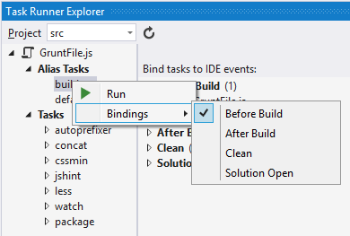
Add Custom Bindings

Slide 23
Demo

Slide 24

Now You’re a Gulp Expert!

Slide 25
thank you i’m Justin. @digitaldrummerj - digitaldrummerj@gmail.com http://digitaldrummerj.me

Slide 26
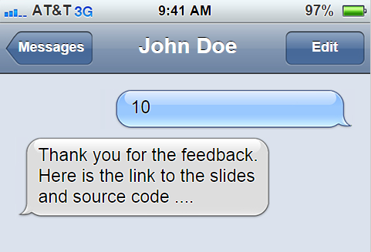
1 480 351 0059

